Slide 1
Codeforces Guide
Author： Greenwicher
2019/11/03
Slides by Hongfei Yan
Notes:
http://blog.greenwicher.com/2017/01/03/codeforces-problemset/
https://github.com/Greenwicher/Awsome-Project/tree/master/Codeforces%20Guide

Slide 2
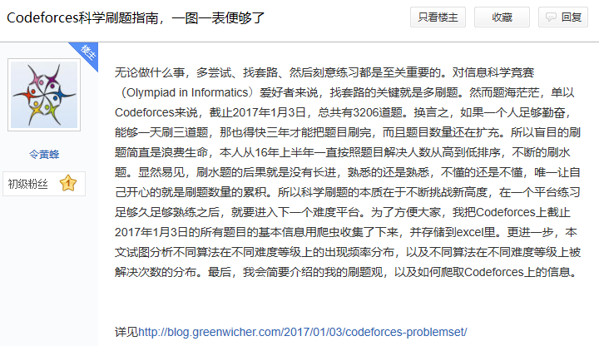
Codeforces吧， http://tieba.baidu.com/f?kw=codeforces&fr=home

Slide 3
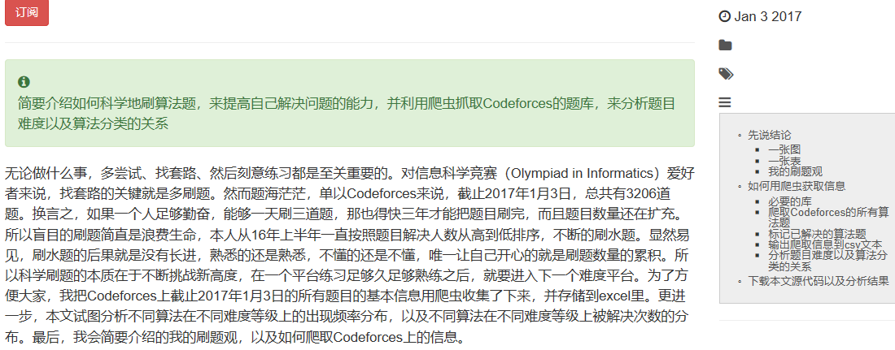
Codeforces科学刷题指南，一图一表便够了 http://blog.greenwicher.com/2017/01/03/codeforces-problemset/
Notes:
http://blog.greenwicher.com/2017/01/03/codeforces-problemset/

Slide 4
大纲
先说结论
一张图、一张表、刷题观
如何用爬虫获取信息
必要的库
爬取Codeforces的所有算法题
标记已解决的算法题
输出爬取信息到csv文本
分析题目难度以及算法分类的关系
下载源代码以及分析结果

Slide 5
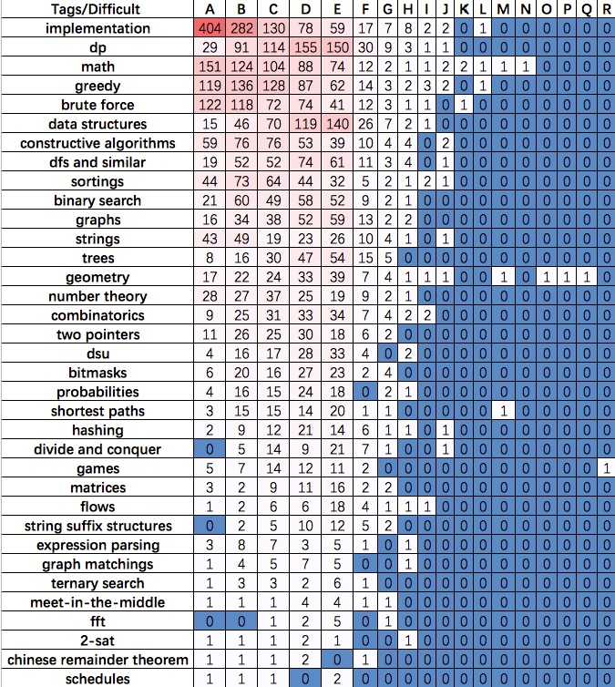
不同算法（第一列）
在不同问题难度（第一行）上的频率分布
大概就可以知道在什么样的水平下应该掌握什么样的算法。按照题号（A、B、C等等）来推断难度。
对简单的A题而言，大部分都是考察基本的编程功底，
诸如implementation（大概就是题目说什么，你做什么就是了），
math（四则运算、取模取整等等）
以及brute force（暴力枚举）
随着难度的增加，比如说E题，主要就在于
考察dp（动态规划），
data structures（数据结构）
高难度题目主要在
math，
geometry（计算几何），
shortest path（图论）
以及games（博弈）上

Slide 6
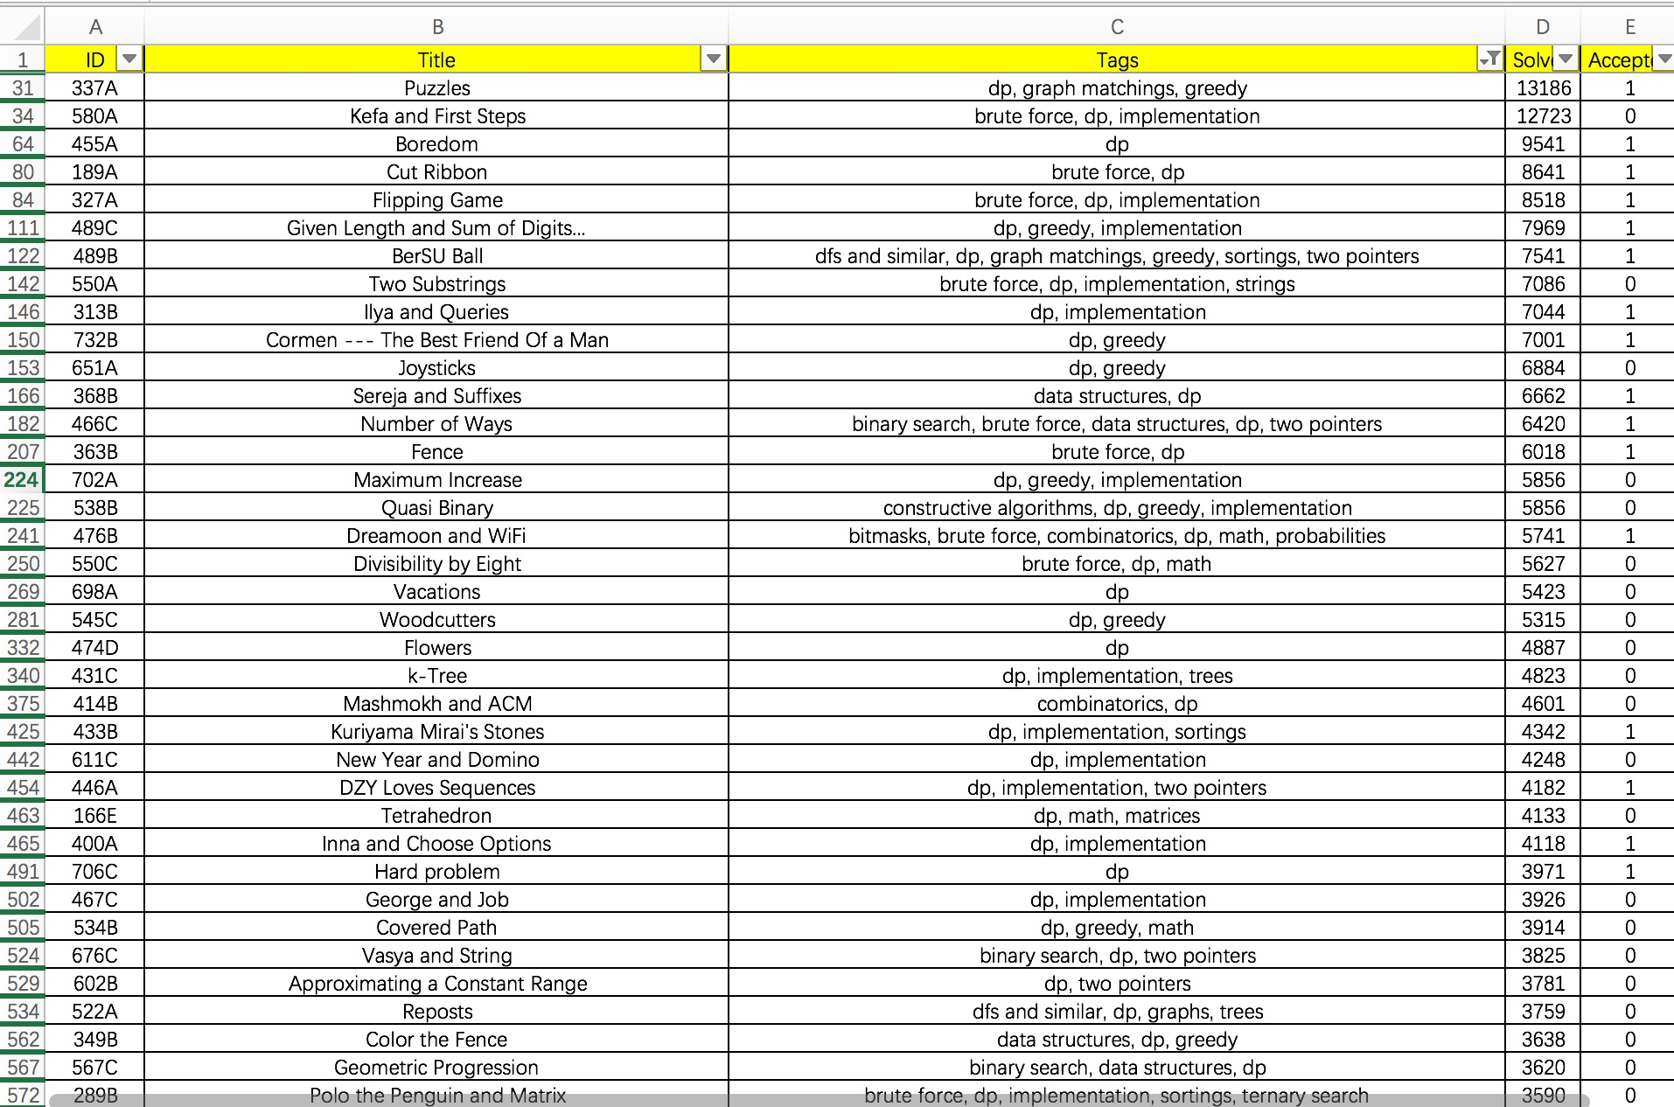
汇总了截止2017年1月3日Codeforces题目上的所有算法题
可以按照解决人数来进行刷题，
二来可以按照题目难度进行刷题，
三来还可以进行主题刷题

Slide 7
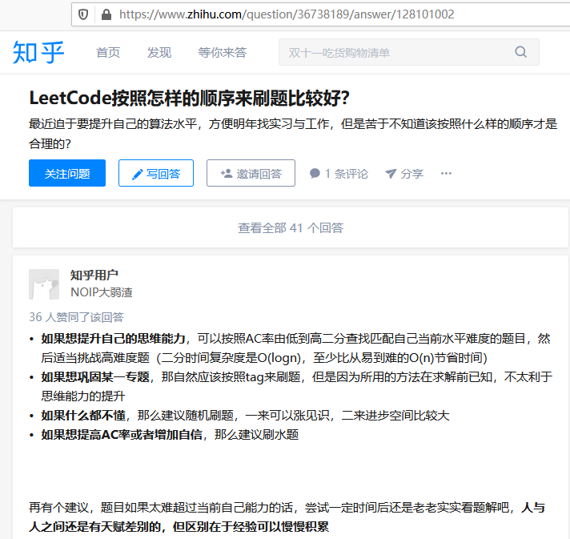
Notes:
https://www.zhihu.com/question/36738189/answer/128101002

Slide 8
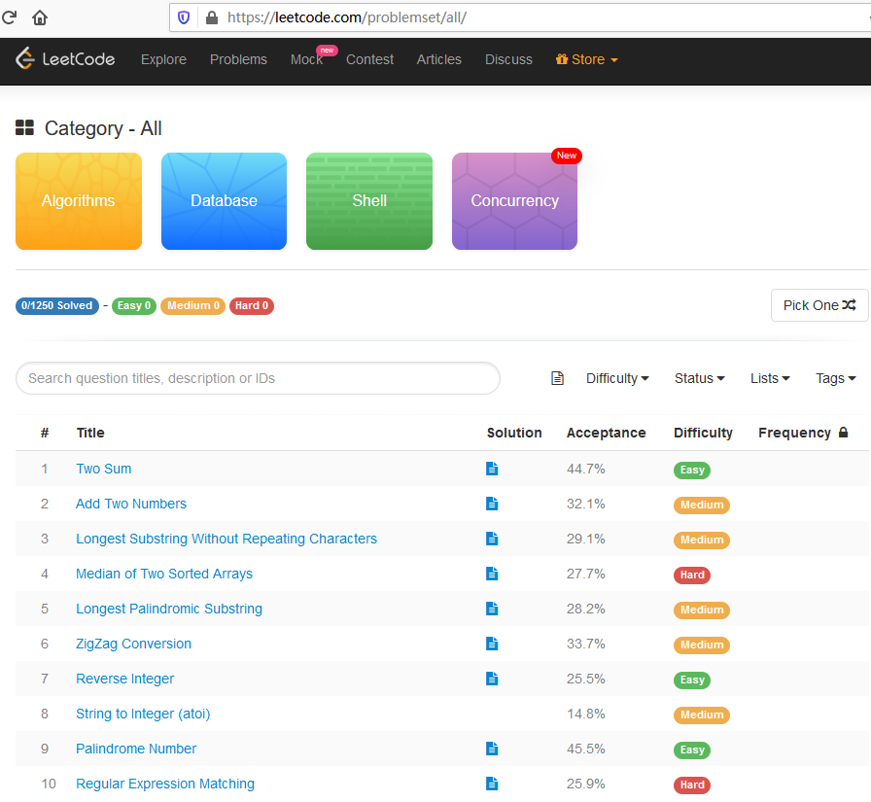
Notes:
https://leetcode.com/problemset/all/

Slide 9
大纲
先说结论
一张图、一张表、刷题观
如何用爬虫获取信息
必要的库
爬取Codeforces的所有算法题
标记已解决的算法题
输出爬取信息到csv文本
分析题目难度以及算法分类的关系
下载源代码以及分析结果

Slide 10
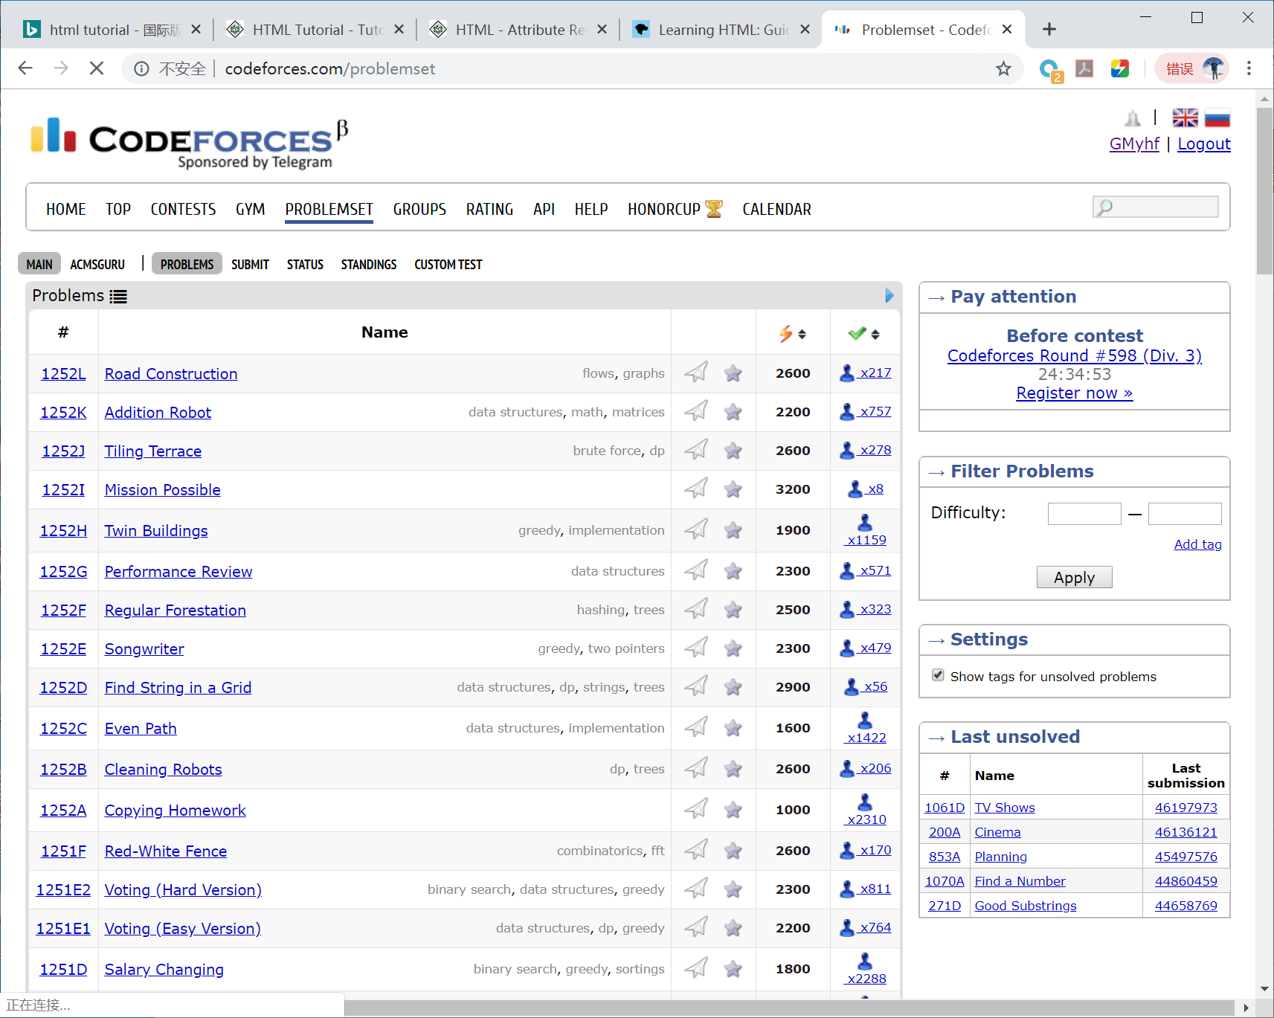

Slide 11
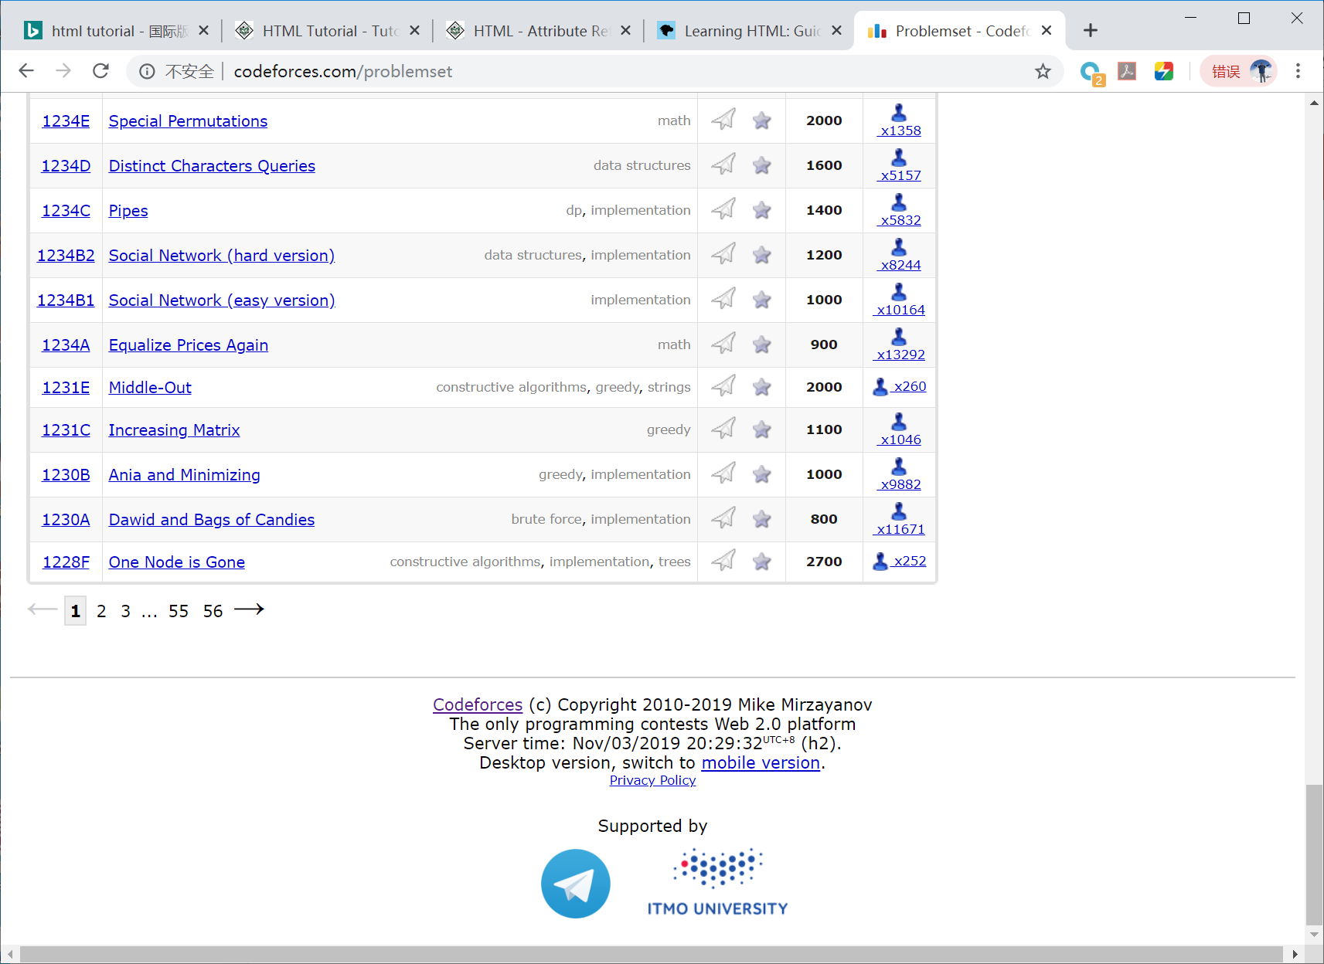

Slide 12
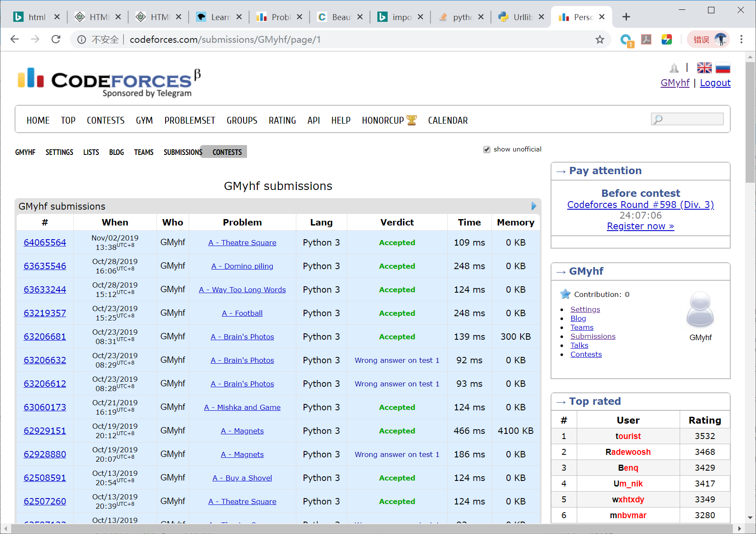
Notes:
http://codeforces.com/submissions/GMyhf/page/1

Slide 13
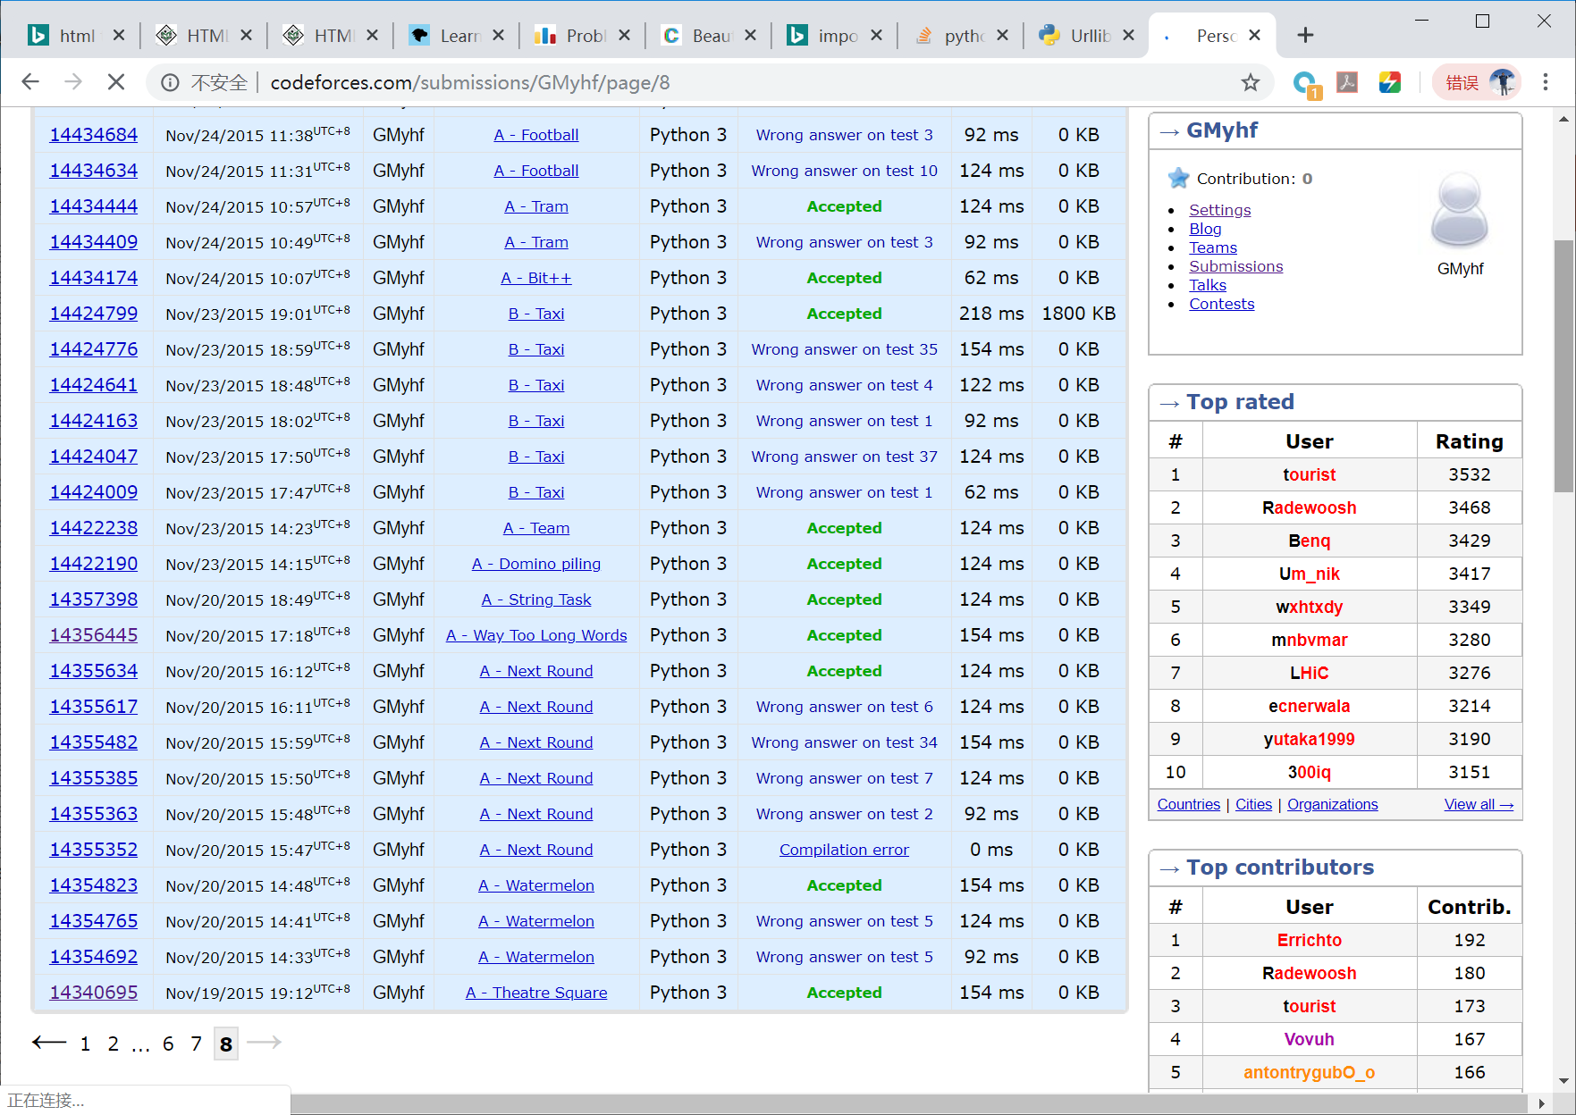
Notes:
http://codeforces.com/submissions/GMyhf/page/8

Slide 14
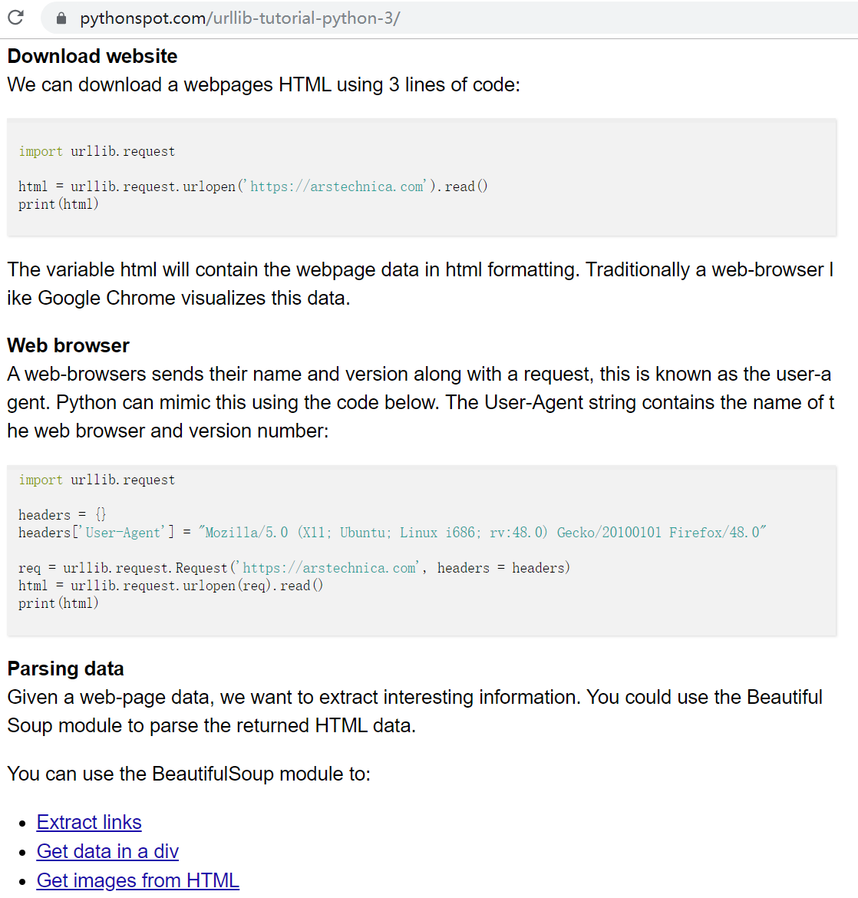
Notes:
Urllib Tutorial Python 3, https://pythonspot.com/urllib-tutorial-python-3/

Slide 15
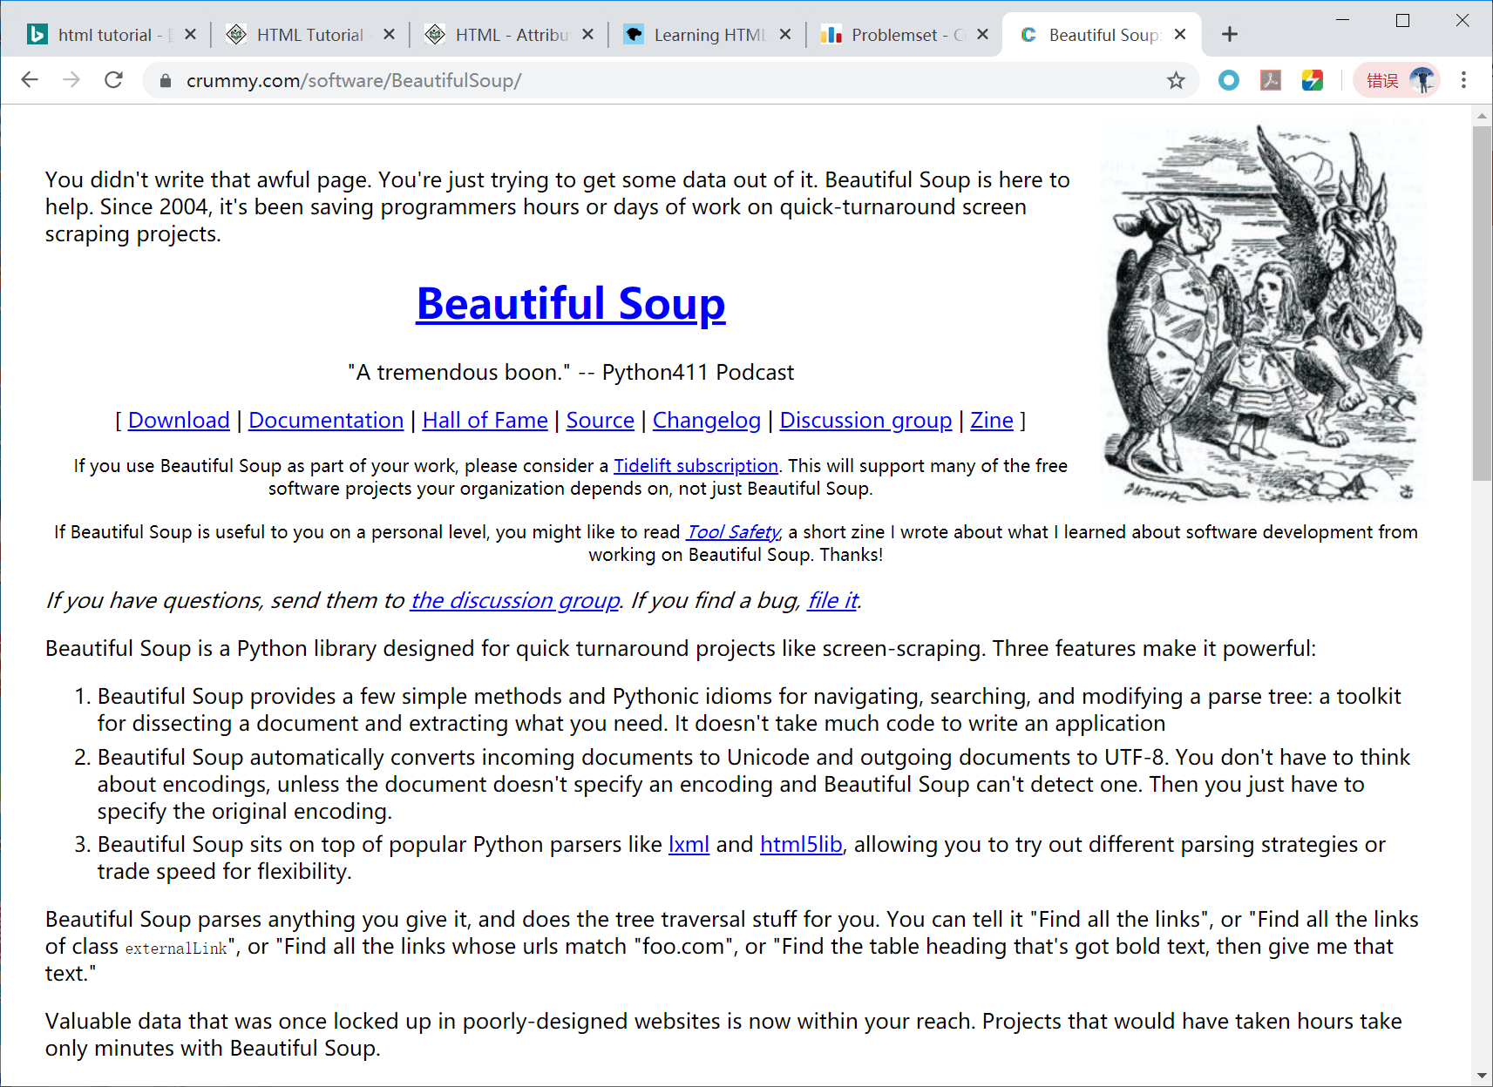
Notes:
https://www.crummy.com/software/BeautifulSoup/

Slide 16
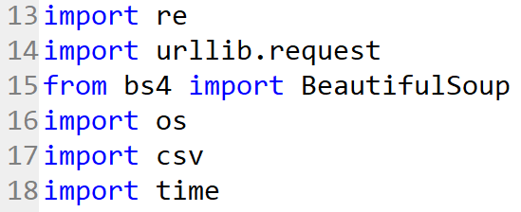
如何用爬虫获取信息
必要的库
Notes:
http://blog.greenwicher.com/2017/01/03/codeforces-problemset/

Slide 17
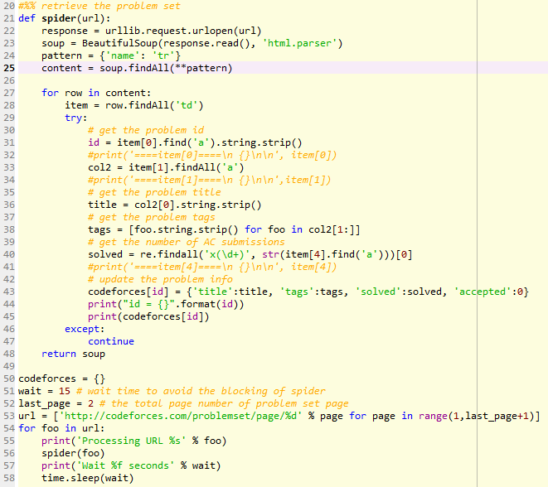
爬取Codeforces 的所有算法题

Slide 18
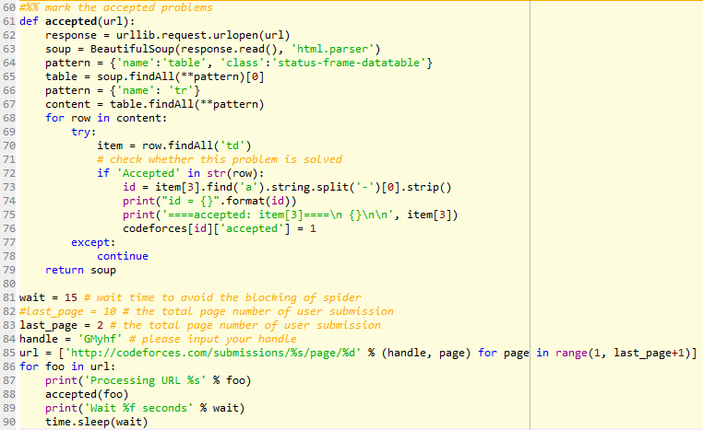
标记已解决的算法题

Slide 19
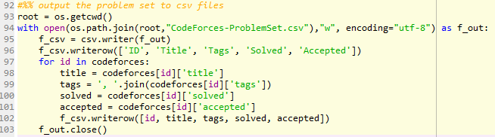
输出爬取信息到csv文本

Slide 20
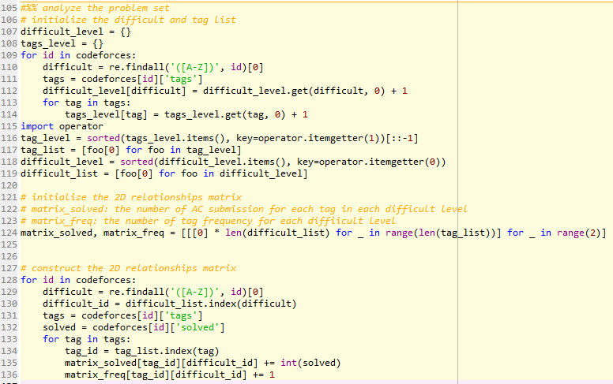
分析题目难度 以及算法分类的关系

Slide 21
下载源代码以及分析结果
源代码以及分析结果请见 Github ，
https://github.com/Greenwicher/Awsome-Project/tree/master/Codeforces%20Guide
或者点击链接下载:
https://pan.baidu.com/s/1o7P8oT8 密码: 8dcb

Slide 22
Updated on Nov. 3, 2019

Slide 23
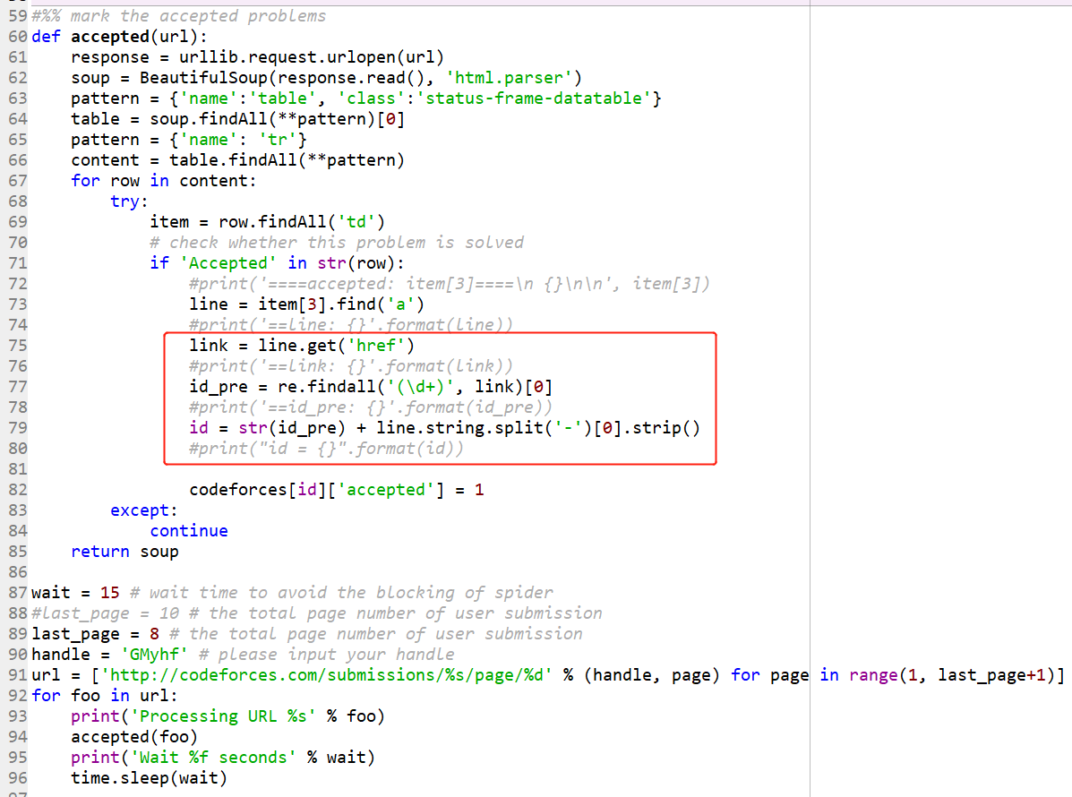
Notes:
def accepted(url):
response = urllib.request.urlopen(url)
soup = BeautifulSoup(response.read(), 'html.parser')
pattern = {'name':'table', 'class':'status-frame-datatable'}
table = soup.findAll(**pattern)[0]
pattern = {'name': 'tr'}
content = table.findAll(**pattern)
for row in content:
try:
item = row.findAll('td')
# check whether this problem is solved
if 'Accepted' in str(row):
#print('====accepted: item[3]====\n {}\n\n', item[3])
line = item[3].find('a')
#print('==line: {}'.format(line))
link = line.get('href')
#print('==link: {}'.format(link))
id_pre = re.findall('(\d+)', link)[0]
#print('==id_pre: {}'.format(id_pre))
id = str(id_pre) + line.string.split('-')[0].strip()
#print("id = {}".format(id))
codeforces[id]['accepted'] = 1
except:
continue
return soup

Slide 24
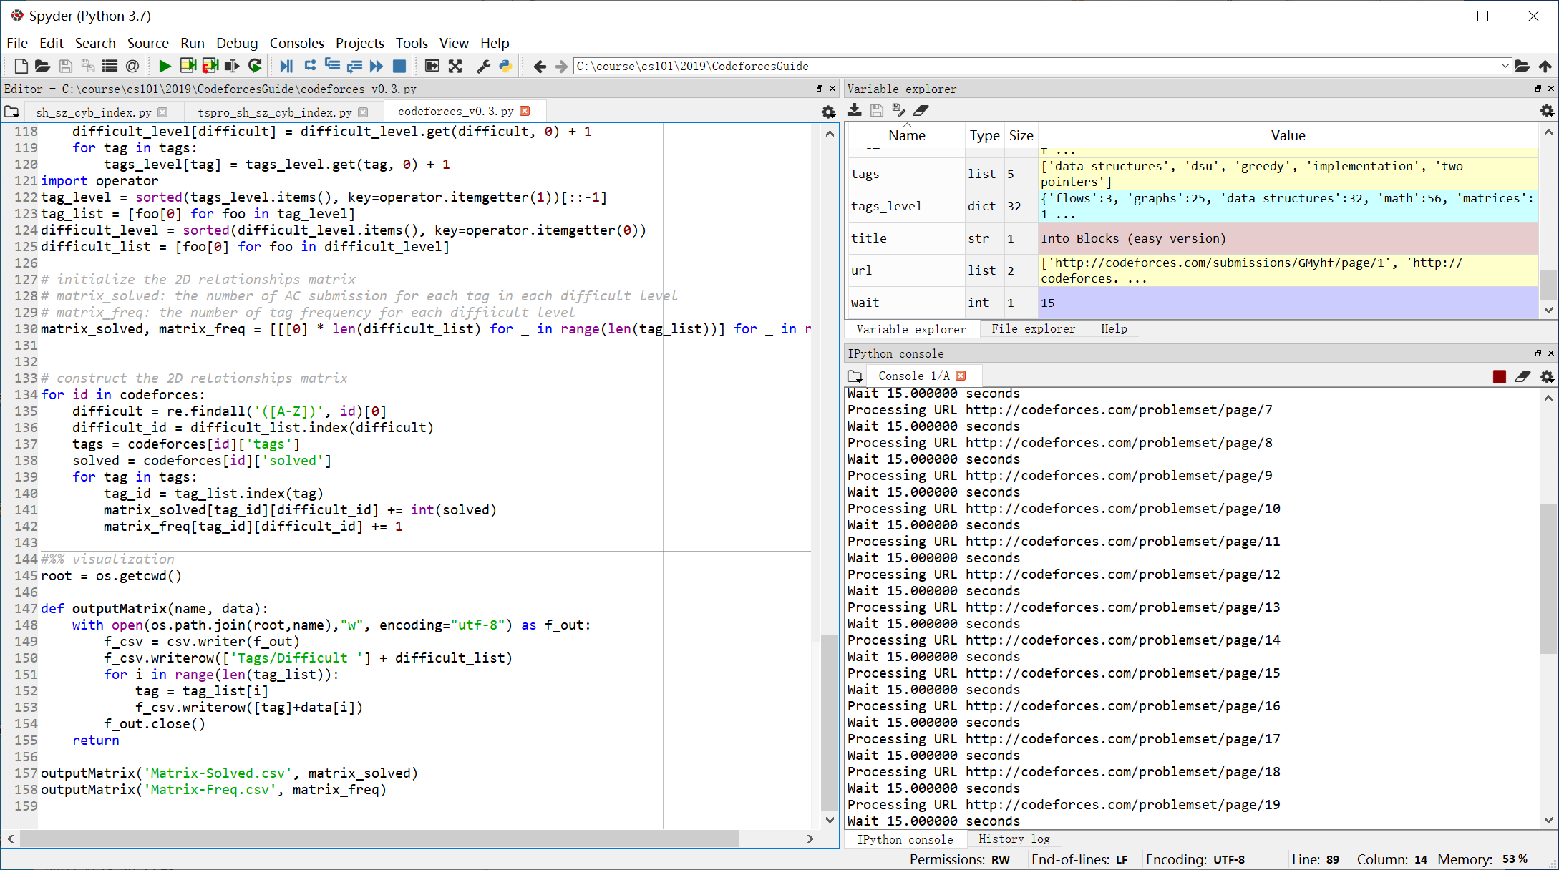

Slide 25
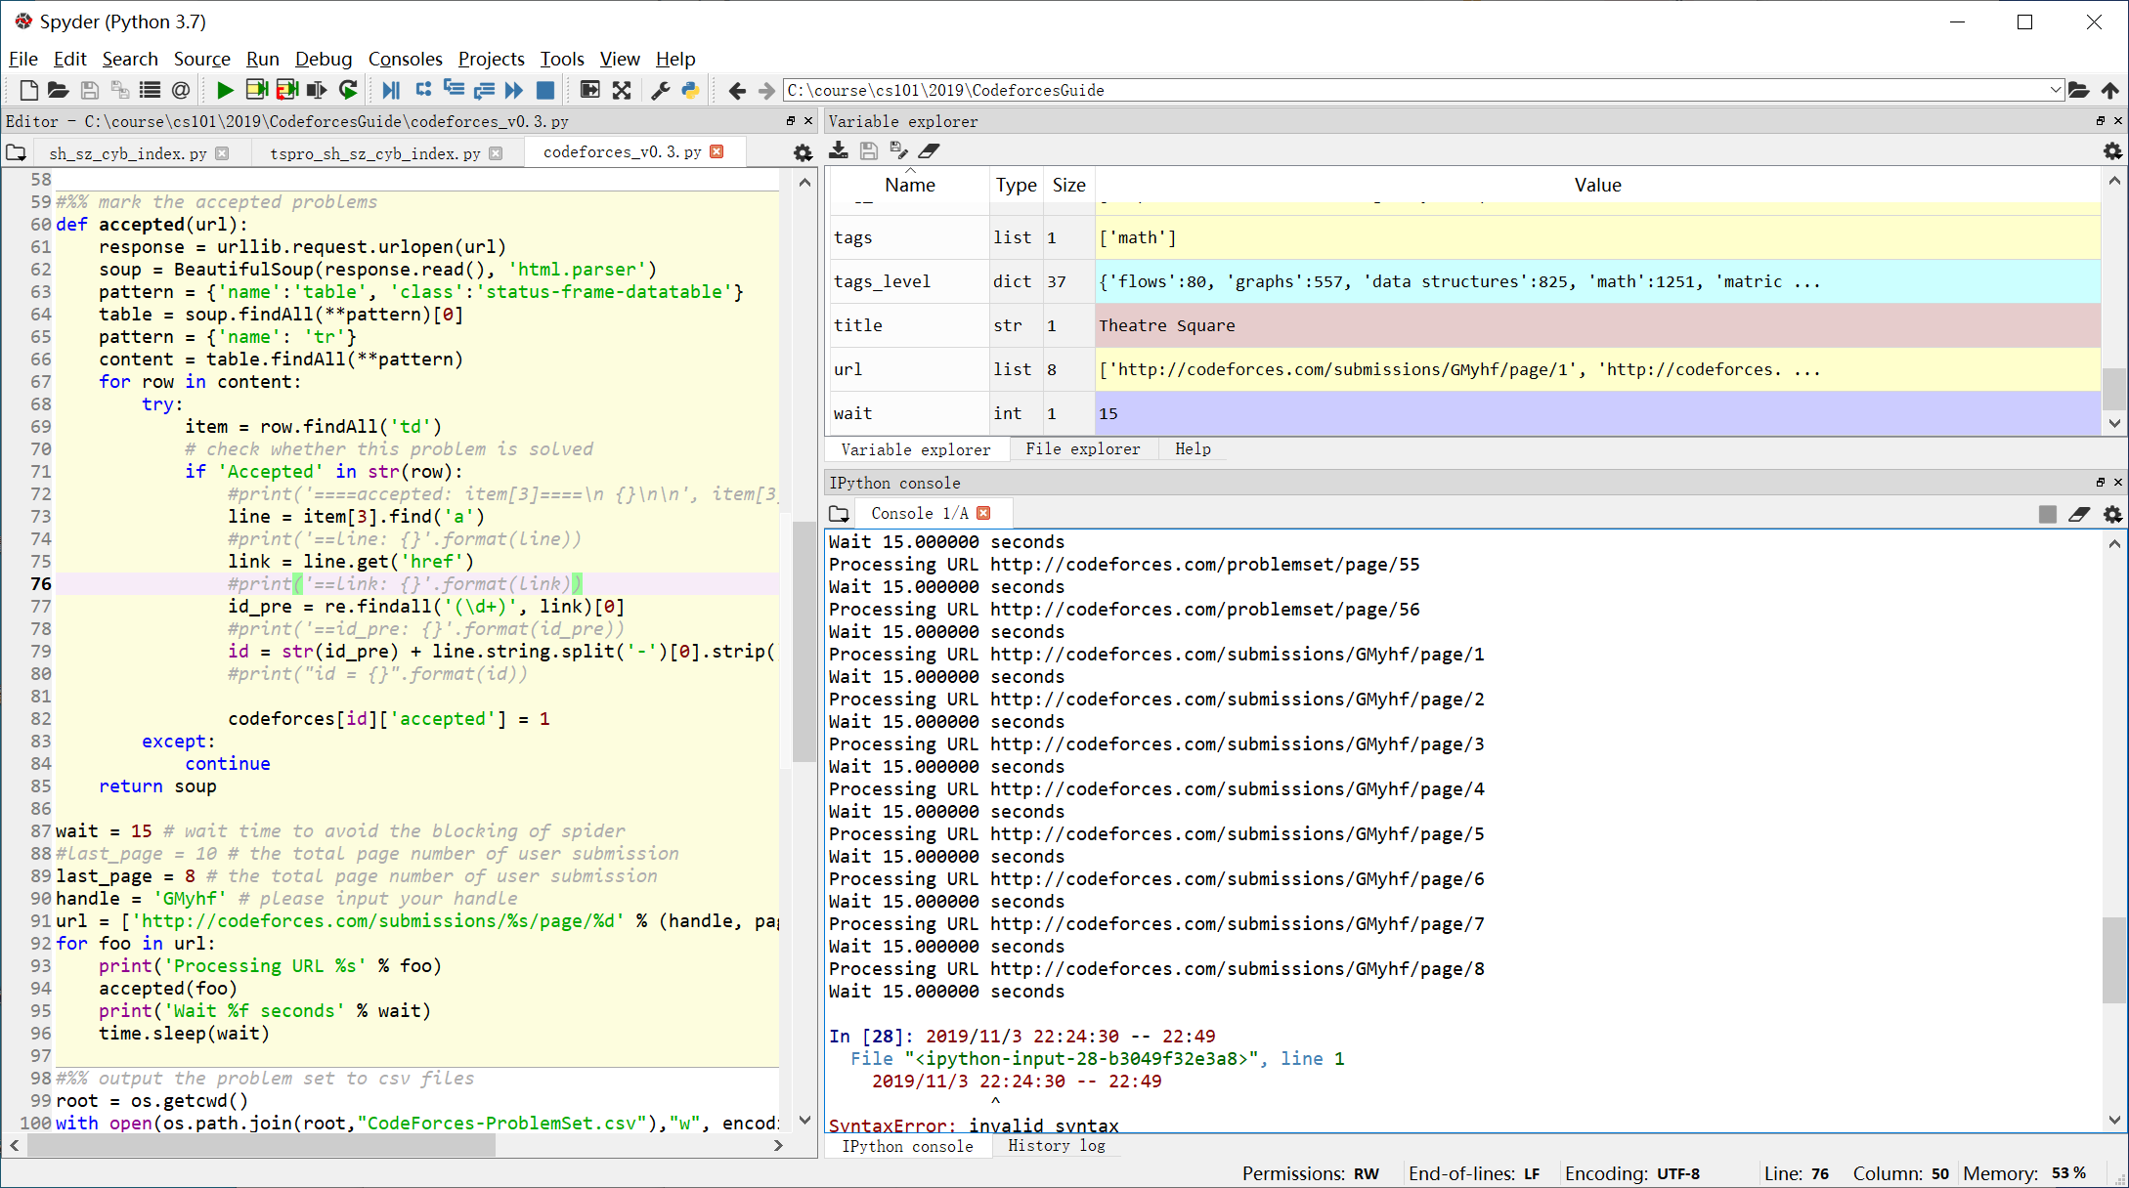
Notes:
2019/11/3 22:24:30 -- 22:49:00

Slide 26
排序

Slide 27
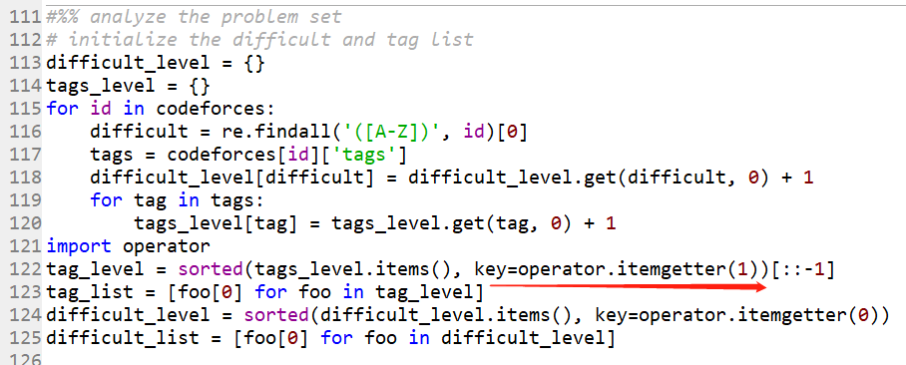

Slide 28
How does operator.itemgetter and sort() work in Python? https://stackoverflow.com/questions/18595686/how-does-operator-itemgetter-and-sort-work-in-python
https://docs.python.org/2/library/operator.html#operator.itemgetter

Slide 29
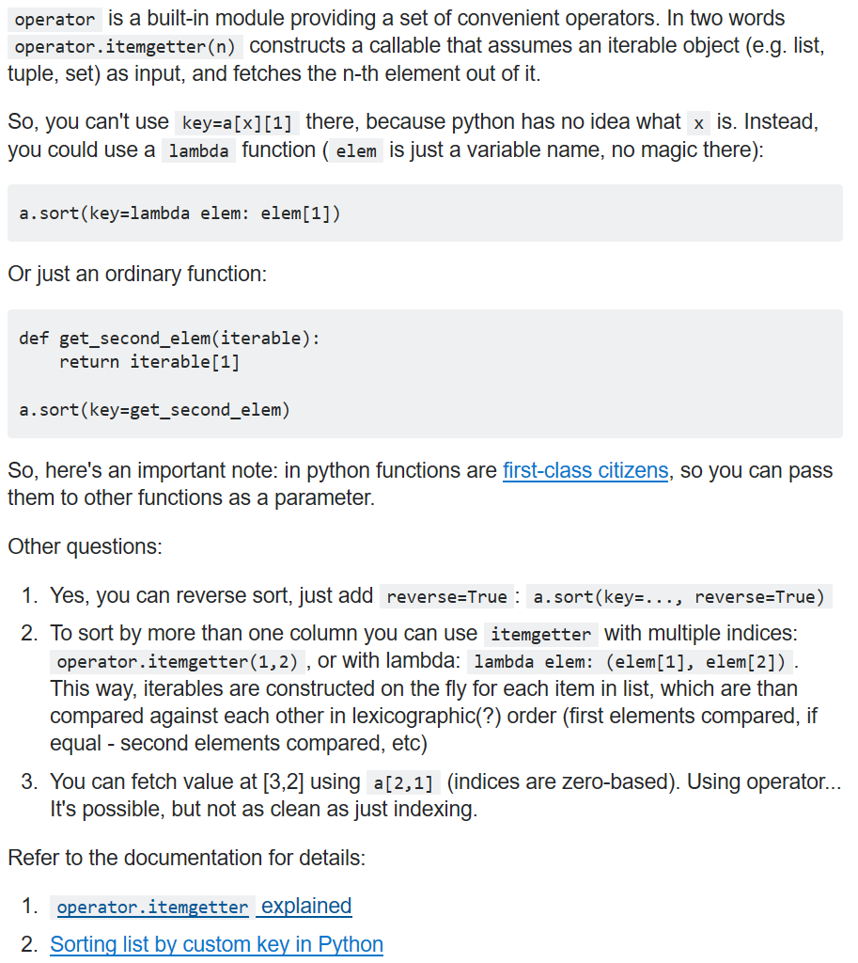

Slide 30
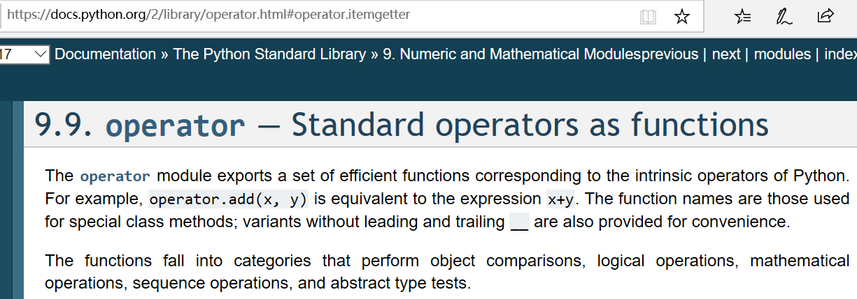
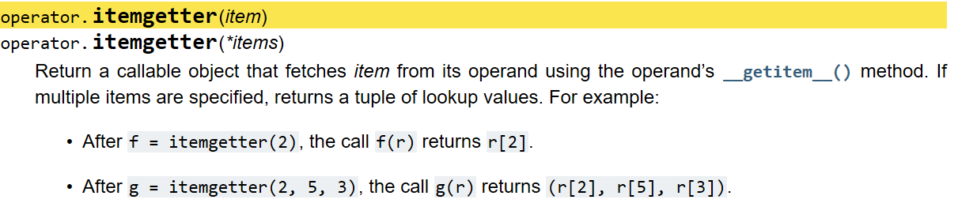
Notes:
https://docs.python.org/2/library/operator.html#operator.itemgetter

Slide 31
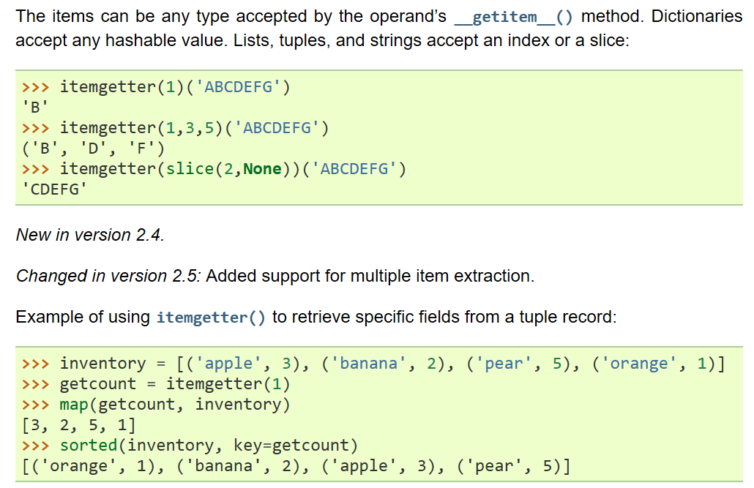

Slide 32
从网页中提取信息

Slide 33
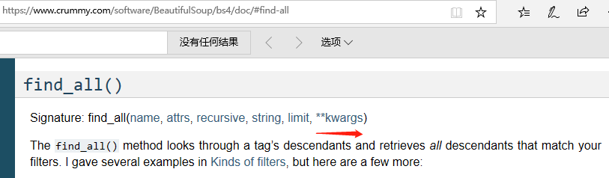
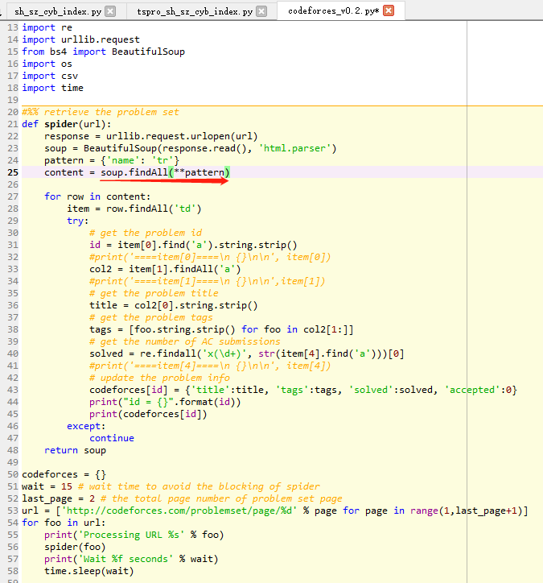
Notes:
https://www.crummy.com/software/BeautifulSoup/bs4/doc/#find-all

Slide 34
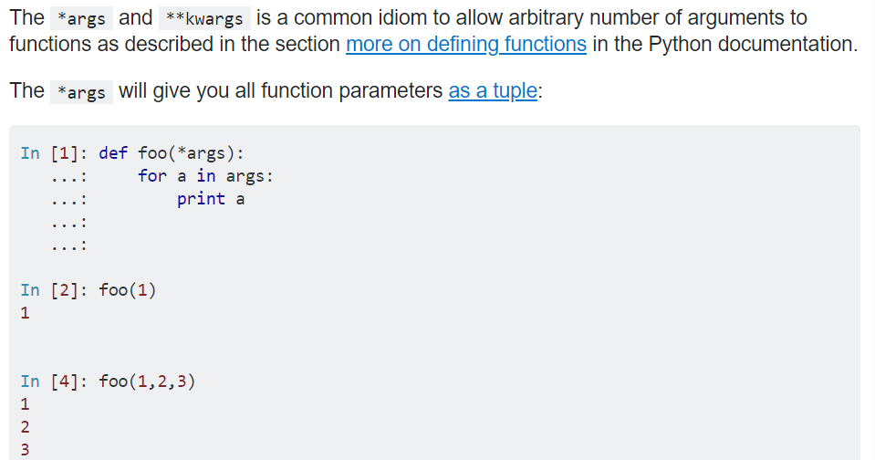
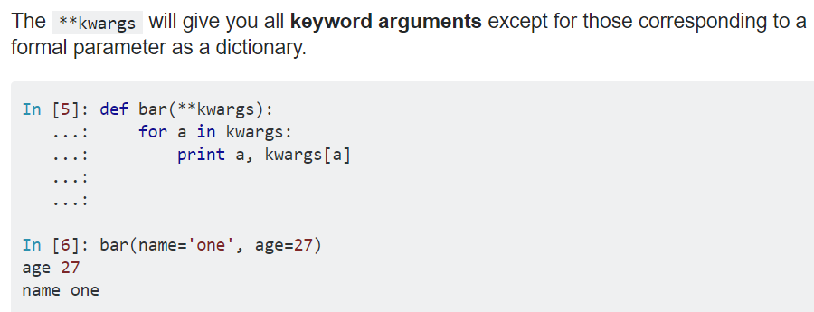
What does ** (double star/asterisk) and * (star/asterisk) do for parameters? https://stackoverflow.com/questions/36901/what-does-double-star-asterisk-and-star-asterisk-do-for-parameters

Slide 35
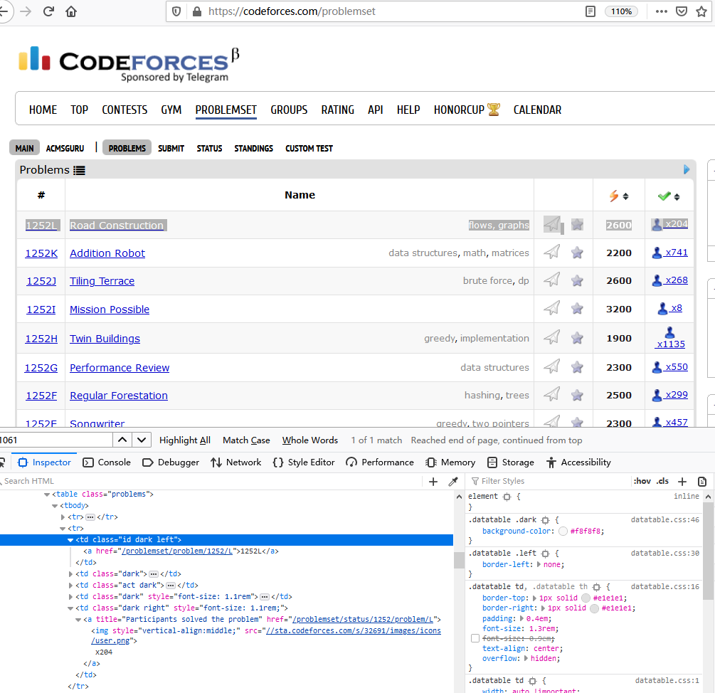

Slide 36
Codeforces_v0.3.py
Updated on Nov. 3, 2019
Notes:
#!/usr/bin/env python3
# -*- coding: utf-8 -*-
#http://blog.greenwicher.com/2017/01/03/codeforces-problemset/
"""
Created on Tue Jan 3 10:29:52 2017 by liuweizhi
updated on Nov. 3, 2019 by Hongfei Yan
"""
import re
import urllib.request
from bs4 import BeautifulSoup
import os
import csv
import time
#%% retrieve the problem set
def spider(url):
response = urllib.request.urlopen(url)
soup = BeautifulSoup(response.read(), 'html.parser')
pattern = {'name': 'tr'}
content = soup.findAll(**pattern)
#content = soup.findAll('tr')
for row in content:
item = row.findAll('td')
try:
# get the problem id
id = item[0].find('a').string.strip()
#print('====item[0]====\n {}\n\n', item[0])
col2 = item[1].findAll('a')
#print('====item[1]====\n {}\n\n',item[1])
# get the problem title
title = col2[0].string.strip()
# get the problem tags
tags = [foo.string.strip() for foo in col2[1:]]
# get the number of AC submissions
solved = re.findall('x(\d+)', str(item[4].find('a')))[0]
#print('====item[4]====\n {}\n\n', item[4])
# update the problem info
codeforces[id] = {'title':title, 'tags':tags, 'solved':solved, 'accepted':0}
#print("id = {}".format(id))
#print(codeforces[id])
except:
continue
return soup
codeforces = {}
wait = 15 # wait time to avoid the blocking of spider
last_page = 56 # the total page number of problem set page
url = ['http://codeforces.com/problemset/page/%d' % page for page in range(1,last_page+1)]
for foo in url:
print('Processing URL %s' % foo)
spider(foo)
print('Wait %f seconds' % wait)
time.sleep(wait)
#%% mark the accepted problems
def accepted(url):
response = urllib.request.urlopen(url)
soup = BeautifulSoup(response.read(), 'html.parser')
pattern = {'name':'table', 'class':'status-frame-datatable'}
table = soup.findAll(**pattern)[0]
pattern = {'name': 'tr'}
content = table.findAll(**pattern)
for row in content:
try:
item = row.findAll('td')
# check whether this problem is solved
if 'Accepted' in str(row):
#print('====accepted: item[3]====\n {}\n\n', item[3])
line = item[3].find('a')
#print('==line: {}'.format(line))
link = line.get('href')
#print('==link: {}'.format(link))
id_pre = re.findall('(\d+)', link)[0]
#print('==id_pre: {}'.format(id_pre))
id = str(id_pre) + line.string.split('-')[0].strip()
#print("id = {}".format(id))
codeforces[id]['accepted'] = 1
except:
continue
return soup
wait = 15 # wait time to avoid the blocking of spider
#last_page = 10 # the total page number of user submission
last_page = 8 # the total page number of user submission
handle = 'GMyhf' # please input your handle
url = ['http://codeforces.com/submissions/%s/page/%d' % (handle, page) for page in range(1, last_page+1)]
for foo in url:
print('Processing URL %s' % foo)
accepted(foo)
print('Wait %f seconds' % wait)
time.sleep(wait)
#%% output the problem set to csv files
root = os.getcwd()
with open(os.path.join(root,"CodeForces-ProblemSet.csv"),"w", encoding="utf-8") as f_out:
f_csv = csv.writer(f_out)
f_csv.writerow(['ID', 'Title', 'Tags', 'Solved', 'Accepted'])
for id in codeforces:
title = codeforces[id]['title']
tags = ', '.join(codeforces[id]['tags'])
solved = codeforces[id]['solved']
accepted = codeforces[id]['accepted']
f_csv.writerow([id, title, tags, solved, accepted])
f_out.close()
#%% analyze the problem set
# initialize the difficult and tag list
difficult_level = {}
tags_level = {}
for id in codeforces:
difficult = re.findall('([A-Z])', id)[0]
tags = codeforces[id]['tags']
difficult_level[difficult] = difficult_level.get(difficult, 0) + 1
for tag in tags:
tags_level[tag] = tags_level.get(tag, 0) + 1
import operator
tag_level = sorted(tags_level.items(), key=operator.itemgetter(1))[::-1]
tag_list = [foo[0] for foo in tag_level]
difficult_level = sorted(difficult_level.items(), key=operator.itemgetter(0))
difficult_list = [foo[0] for foo in difficult_level]
# initialize the 2D relationships matrix
# matrix_solved: the number of AC submission for each tag in each difficult level
# matrix_freq: the number of tag frequency for each diffiicult level
matrix_solved, matrix_freq = [[[0] * len(difficult_list) for _ in range(len(tag_list))] for _ in range(2)]
# construct the 2D relationships matrix
for id in codeforces:
difficult = re.findall('([A-Z])', id)[0]
difficult_id = difficult_list.index(difficult)
tags = codeforces[id]['tags']
solved = codeforces[id]['solved']
for tag in tags:
tag_id = tag_list.index(tag)
matrix_solved[tag_id][difficult_id] += int(solved)
matrix_freq[tag_id][difficult_id] += 1
#%% visualization
root = os.getcwd()
def outputMatrix(name, data):
with open(os.path.join(root,name),"w", encoding="utf-8") as f_out:
f_csv = csv.writer(f_out)
f_csv.writerow(['Tags/Difficult '] + difficult_list)
for i in range(len(tag_list)):
tag = tag_list[i]
f_csv.writerow([tag]+data[i])
f_out.close()
return
outputMatrix('Matrix-Solved.csv', matrix_solved)
outputMatrix('Matrix-Freq.csv', matrix_freq)

Slide 37
结果可视化

Slide 38
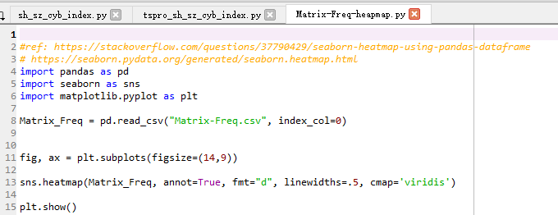
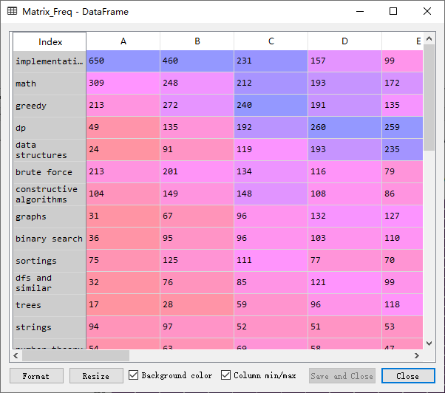
Notes:
#ref: https://stackoverflow.com/questions/37790429/seaborn-heatmap-using-pandas-dataframe
# https://seaborn.pydata.org/generated/seaborn.heatmap.html
import pandas as pd
import seaborn as sns
import matplotlib.pyplot as plt
Matrix_Freq = pd.read_csv("Matrix-Freq.csv", index_col=0)
fig, ax = plt.subplots(figsize=(14,9))
sns.heatmap(Matrix_Freq, annot=True, fmt="d", linewidths=.5, cmap='viridis')
plt.show()

Slide 39
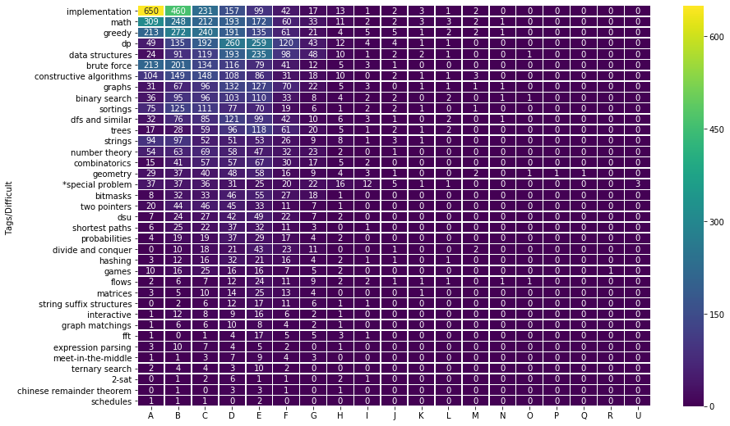

Slide 40
增加一个热力图的例子
Stock Return Heatmap using Seaborn, https://pythonforfinance.net/2018/02/07/stock-return-heatmap-using-seaborn/
creating an annotated heatmap for the Dow 30 stock returns using the Python Seaborn package.

Slide 41
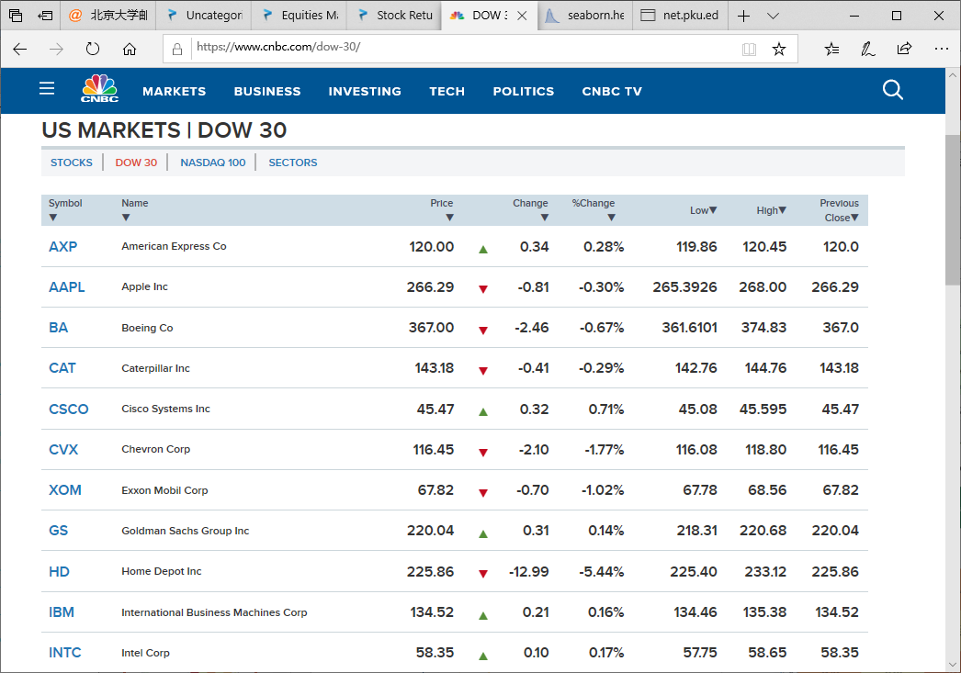
Notes:
https://www.cnbc.com/dow-30/

Slide 42
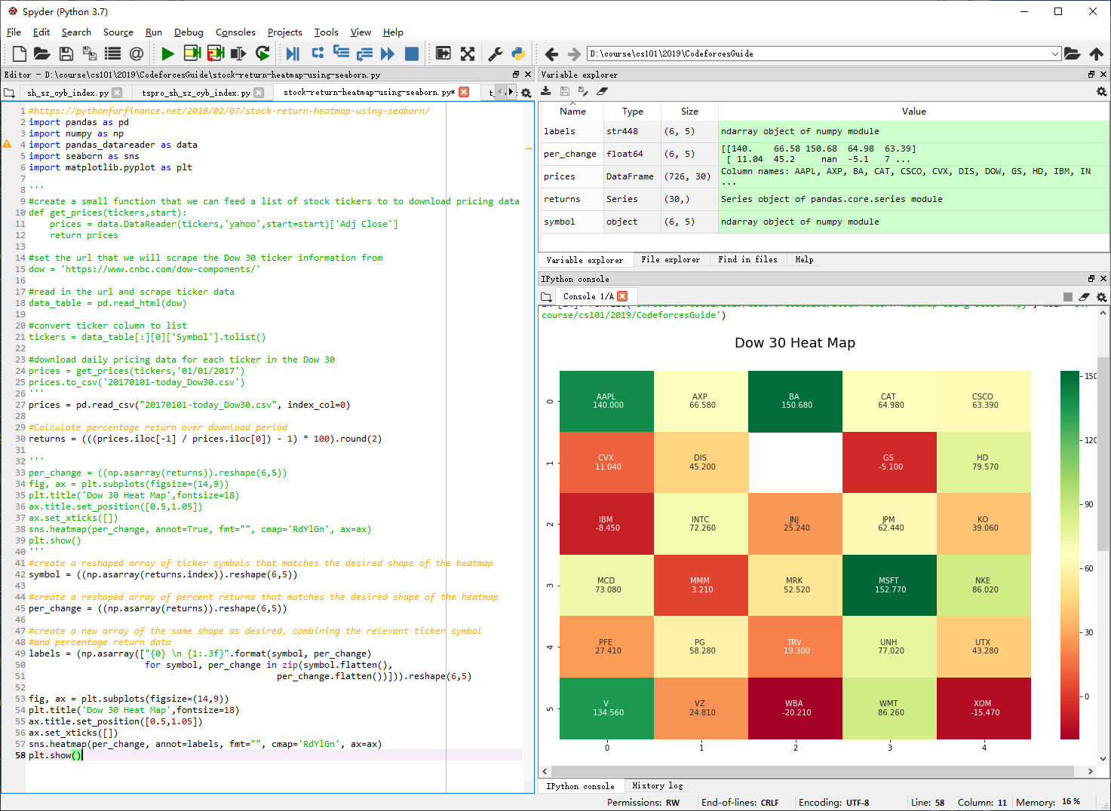
Notes:
#https://pythonforfinance.net/2018/02/07/stock-return-heatmap-using-seaborn/
import pandas as pd
import numpy as np
import pandas_datareader as data
import seaborn as sns
import matplotlib.pyplot as plt
'''
#create a small function that we can feed a list of stock tickers to to download pricing data
def get_prices(tickers,start):
prices = data.DataReader(tickers,'yahoo',start=start)['Adj Close']
return prices
#set the url that we will scrape the Dow 30 ticker information from
dow = 'https://www.cnbc.com/dow-components/'
#read in the url and scrape ticker data
data_table = pd.read_html(dow)
#convert ticker column to list
tickers = data_table[:][0]['Symbol'].tolist()
#download daily pricing data for each ticker in the Dow 30
prices = get_prices(tickers,'01/01/2017')
prices.to_csv('20170101-today_Dow30.csv')
'''
prices = pd.read_csv("20170101-today_Dow30.csv", index_col=0)
#Calculate percentage return over download period
returns = (((prices.iloc[-1] / prices.iloc[0]) - 1) * 100).round(2)
'''
per_change = ((np.asarray(returns)).reshape(6,5))
fig, ax = plt.subplots(figsize=(14,9))
plt.title('Dow 30 Heat Map',fontsize=18)
ax.title.set_position([0.5,1.05])
ax.set_xticks([])
sns.heatmap(per_change, annot=True, fmt="", cmap='RdYlGn', ax=ax)
plt.show()
'''
#create a reshaped array of ticker symbols that matches the desired shape of the heatmap
symbol = ((np.asarray(returns.index)).reshape(6,5))
#create a reshaped array of percent returns that matches the desired shape of the heatmap
per_change = ((np.asarray(returns)).reshape(6,5))
#create a new array of the same shape as desired, combining the relevant ticker symbol
#and percentage return data
labels = (np.asarray(["{0} \n {1:.3f}".format(symbol, per_change)
for symbol, per_change in zip(symbol.flatten(),
per_change.flatten())])).reshape(6,5)
fig, ax = plt.subplots(figsize=(14,9))
plt.title('Dow 30 Heat Map',fontsize=18)
ax.title.set_position([0.5,1.05])
ax.set_xticks([])
sns.heatmap(per_change, annot=labels, fmt="", cmap='RdYlGn', ax=ax)
plt.show()

Slide 43
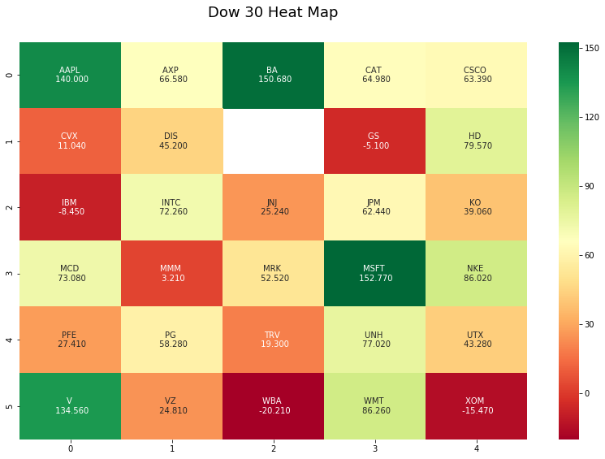

Slide 44
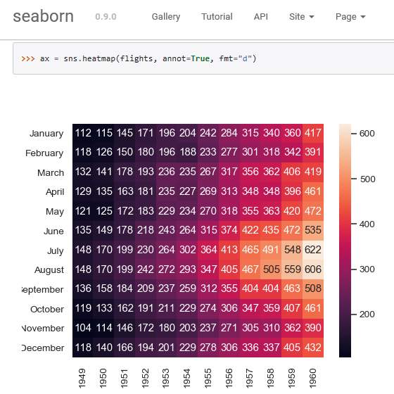
seaborn.heatmap, https://seaborn.pydata.org/generated/seaborn.heatmap.html

